Slide 1

Query Optimization - Indexes
B-Tree Index
TEXT
TEXT

Slide 2

B-Tree Index
01
  The default type of index in Oracle is B-Tree index
02
  B stands for Balanced
  This index type is known as B-tree because the table row identifier (ROWID) and associated column values are stored within index blocks in a balanced tree- like structure.
03

Slide 3
Mechanism of
B-Tree Index
01
  At the top of the index is the root, which contains entries that point to the next level in the index.
02
  At the next level are branch blocks, which in turn point to blocks at the next level in the index.
03
  At the lowest level are the leaf nodes, which contain the index entries that point to rows in the table.

Slide 4
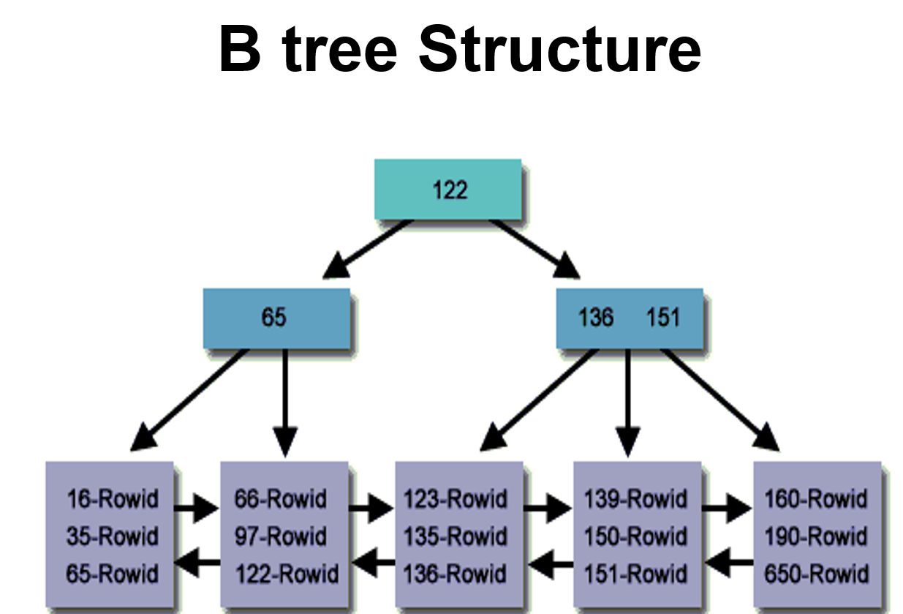
  Creating a B-Tree Index on the Order ids of Sales table.
Index Values are by default sorted Ascending, i.e., Left (min) to Right (max)
0
100
But while creating index we can specify that sorting as Descending, i.e., Left (max) to Right (min) which really helps in certain scenarios!!
100
0

Slide 5
When to create
B-Tree Index
Suitable for the columns having high cardinality with less nulls (means distinct values are more in the column).
Implicit Index Creation → Whenever a primary key or unique key is created on a column then implicitly a B-Tree and Unique type of index gets created for that column!!

Slide 6
B-Tree Index
Let’s explore the B-Tree Index in detail.

